Slide 1
HW3 – Vending Machine
Mark Dannemiller

Slide 2
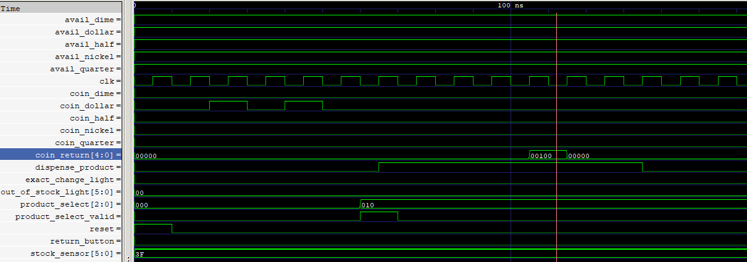
// -------------------------------------------
// Test 1: Purchase a product (product index 2)
// Insert coins to reach $2.00 (200 cents) then select.
// Expected: product dispensed and 25 cents change returned.
// -------------------------------------------
$2.00 inserted
25 cents returned
Selection and confirmation signal

Slide 3
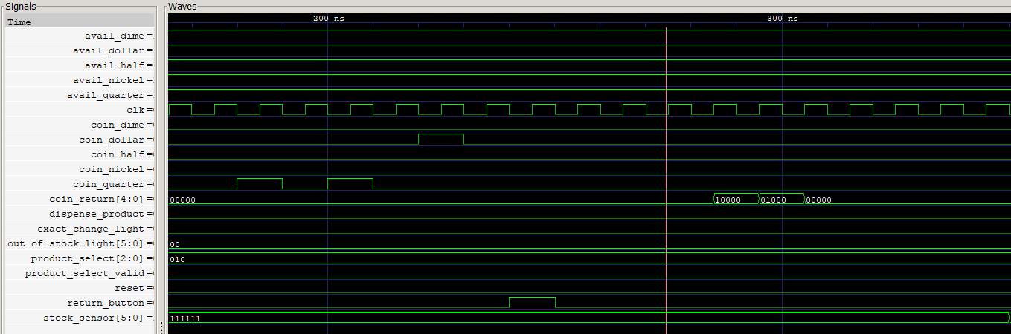
// -------------------------------------------
// Test 2: Cancel transaction via the return button.
// Insert coins that sum to 150 cents then press return.
// -------------------------------------------
Return same as change
Selection never confirmed, return button hit

Slide 4
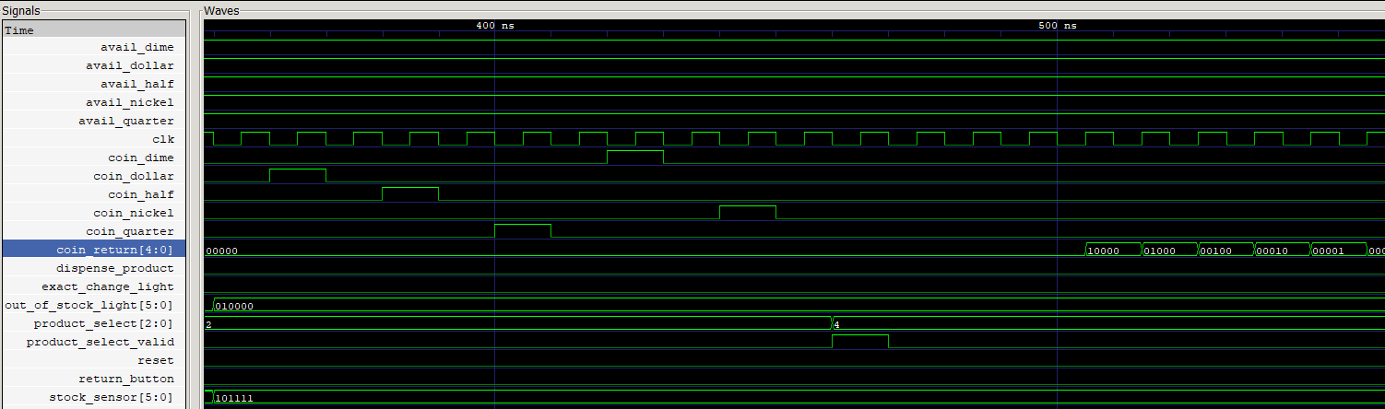
// -------------------------------------------
// Test 3: Attempt purchase when item is out–of–stock.
// Mark product 4 as out–of–stock.
// Insert coins totaling 190 cents then select product 4.
// Expected: no product dispensed; full balance returned.
// -------------------------------------------
Coins are returned, no product
Select 4
Index 4 out of stock

Slide 5
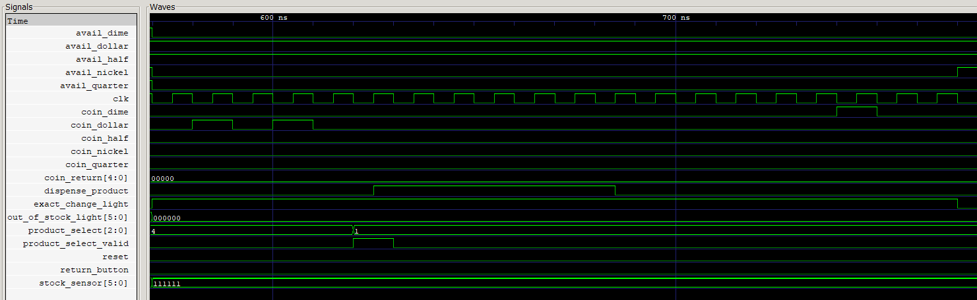
// -------------------------------------------
// Test 4: "Steal" Scenario: Insufficient coin inventory for making change.
// Setup: Insert $2.00 then select a product (product index 1).
// But set avail_quarter, avail_dime, and avail_nickel to 0 so that 25¢ change
// cannot be made (even though the product is in stock).
// Expected: Product dispensed and the extra 25¢ is "stolen" (no coin returned).
// -------------------------------------------
Availability sensors driven low
No return, 25¢ stolen
Light goes high

Slide 6
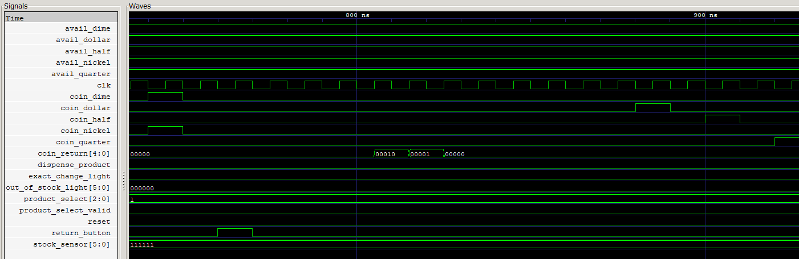
// -------------------------------------------
// Test 5: Multiple Coins in the Same Cycle:
// Drive more than one coin signal in one clock cycle.
// Expected: Balance should increase by the sum of the coins.
// -------------------------------------------
2 coins at once
Balance understood, coins returned correctly

Slide 7

// -------------------------------------------
// Test 6: Exact Change Transaction:
// Insert exactly 175 cents (using coin_dollar, coin_half, and coin_quarter)
// then select a product.
// Expected: Product dispensed, no change returned, balance resets to zero.
// -------------------------------------------
$1.75 inserted
Nothing returned, exact change

Slide 8
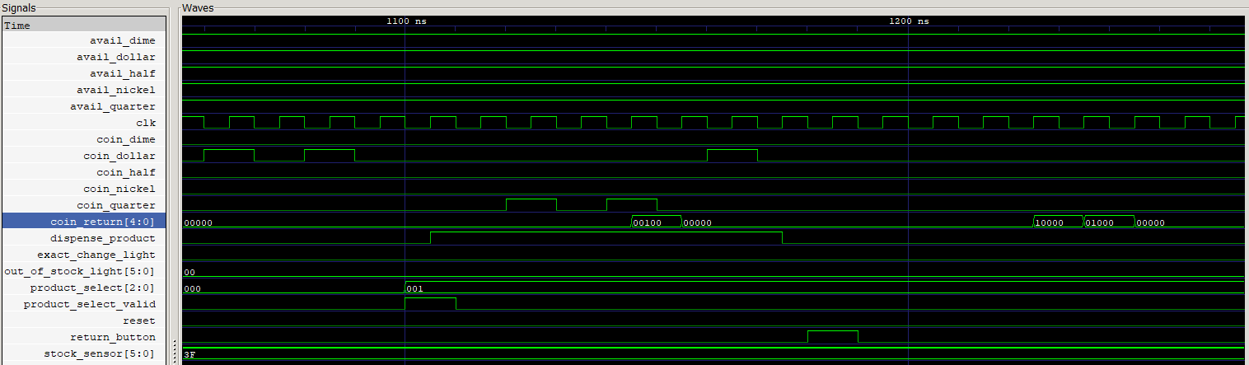
// -------------------------------------------
// Test 7: Rapid Successive Transactions:
// Immediately begin a new transaction after one completes.
// Expected: The machine resets correctly between transactions.
// -------------------------------------------
$2.00 inserted by person 1
$1.50 inserted during change making
The second guy changes his mind and wants money back. $1.50 is returned
The case where the next guy in line just couldn’t wait

Slide 9

// -------------------------------------------
// Test 8: Mid-Transaction Reset:
// While coins are being accumulated, assert the reset signal.
// Expected: The state machine resets immediately, clearing the balance and outputs.
// -------------------------------------------
Machine reset triggered, person does not get their money back

Slide 10
